Slide 1
Linux and Networking Basics
Guillermo Gonzalez

Slide 2
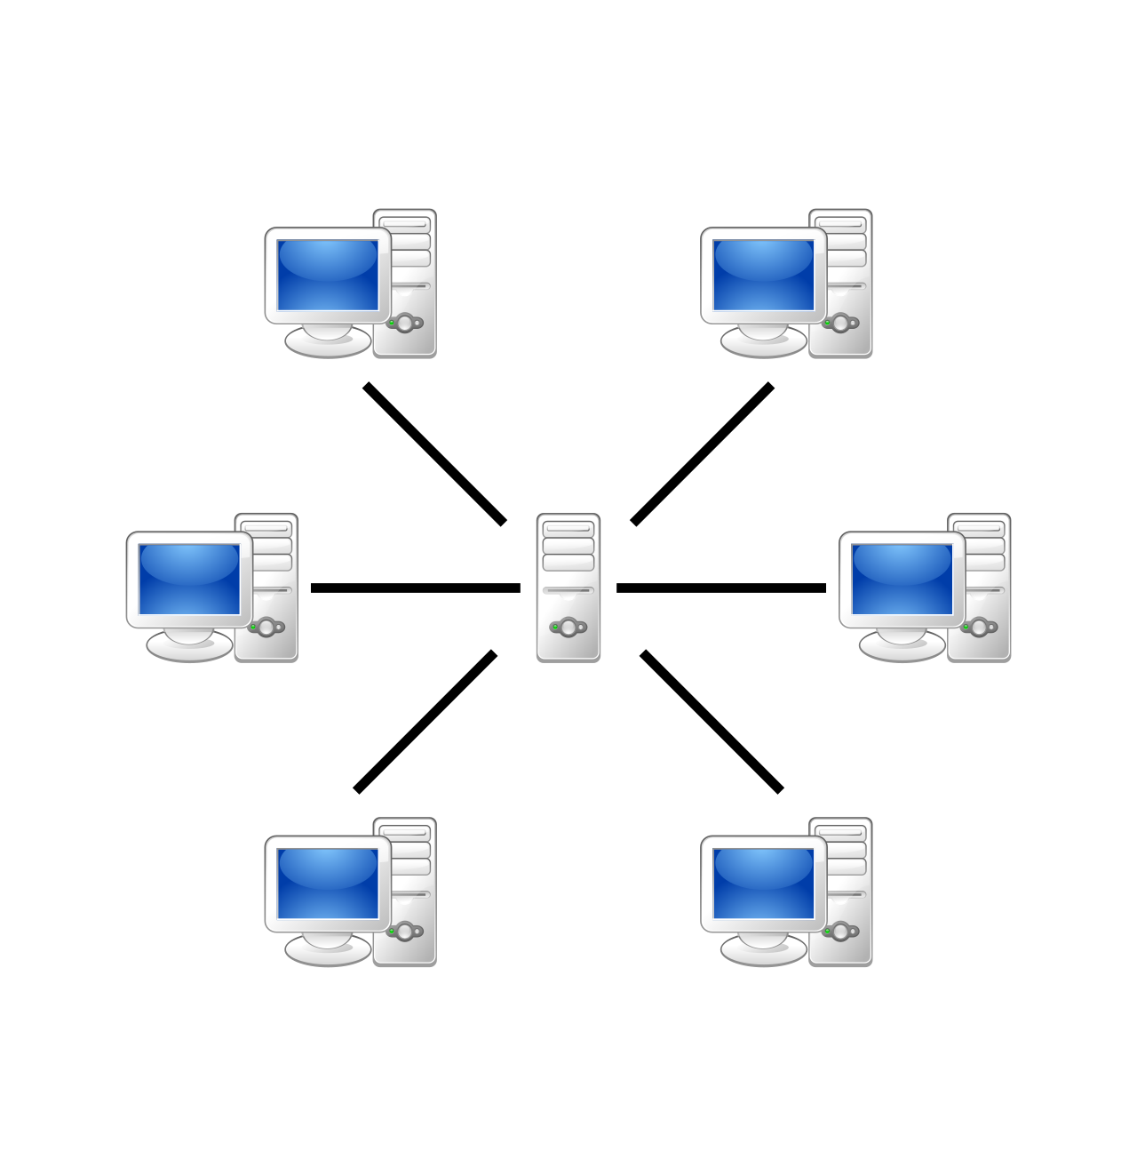
Servers and Clients
Servers provide functionality to other programs or devices (clients)
Database
File
Mail
Web
Application

Slide 3
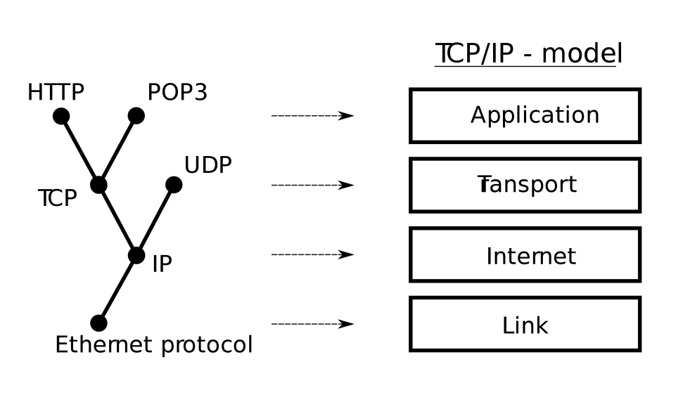
Protocols and ports
Set of rules or procedures for transmitting data between electronic devices
TCP/IP
HTTP(S)→80,443
SMTP→25
SSH→22
FTP→21

Slide 4
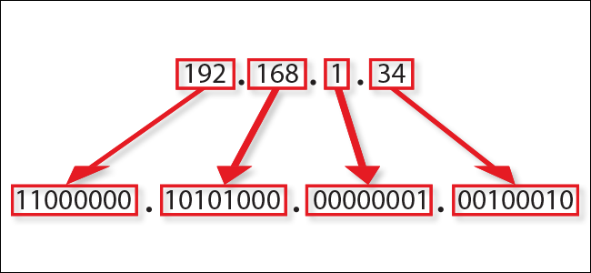
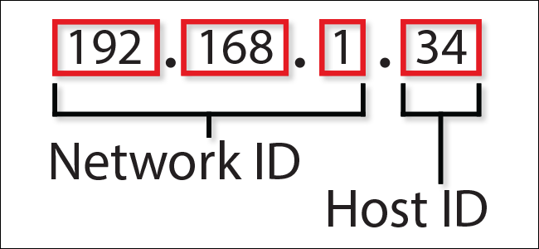
Internet Protocol (IP)
IPv4: 4.3 (2³²) Billion addresses. Example:10.200.20.108
IPv6: 2¹²⁸ or approximately 3.4×10³⁸ addresses: 340 undecillion, or 340 billion billion billion billion addresses. Example: 2001:0db8:85a3:0000:0000:8a2e:0370:7334

Slide 5
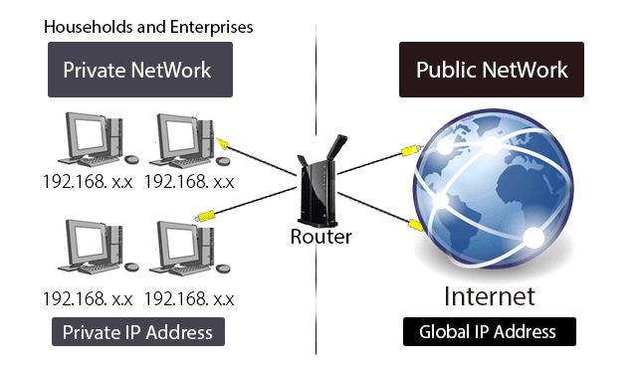
IP Address
An IP address uniquely identifies a device on a network.
Private
Public
https://www.whatismyip.com/

Slide 6
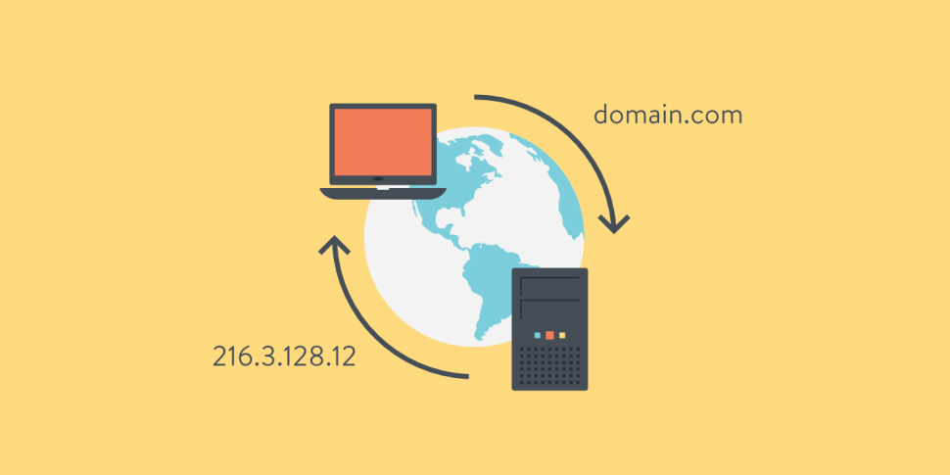
Domain Name System (DNS)
Is the phonebook of the Internet
DNS translates domain names to IP addresses so browsers can load Internet resources.

Slide 7

UNIX
UNIX is an operating system which was first developed in the 1970s
CASE SENSITIVE
Sun Solaris
GNU/Linux
MacOS X.

Slide 8

Linux
Linux is an operating system built by Linus Torvalds in 1991.
RedHat
Ubuntu
CentOS
Fedora

Slide 9
Basic Linux Commands
ls: list files
pwd: print working directory
mkdir: create a directory
rm: delete a file(s)
cp: copy a file(s)
mv: rename a file(s)
chown: Change ownership of file(s)
chmod: change file permissions
man: documentation
Unix/Linux Command Reference

Slide 10
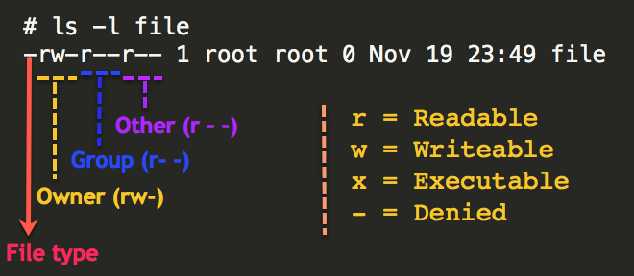
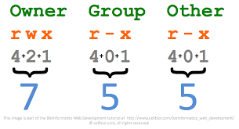
Permissions
Read (r) : 4
Write (w): 2
Execute (x):1
chmod
chown

Slide 11
Connect to a server
Server: omics10
Account: userx
Password: userx

